Slide 1
Hotel Booking Cancellation Prediction
Decision Systems
By John Buczkowski

Slide 2
Contents / Agenda
Data Dictionary
Business Problem Overview and Solution Approach
EDA Results
Data Preprocessing
Model Performance Summary
Conclusions and Recommendations
Appendix

Slide 3
Data Dictionary
The data contains the different attributes of customers' booking details. The detailed data dictionary is given below:
Booking_ID: the unique identifier of each booking
no_of_adults: Number of adults
no_of_children: Number of Children
no_of_weekend_nights: Number of weekend nights (Saturday or Sunday) the guest stayed or booked to stay at the hotel
no_of_week_nights: Number of weeknights (Monday to Friday) the guest stayed or booked to stay at the hotel
required_car_parking_space: Does the customer require a car parking space? (0 - No, 1- Yes)
room_type_reserved: Type of room reserved by the customer. The values are ciphered (encoded) by INN Hotels Group

Slide 4
Data Dictionary
lead_time: Number of days between the date of booking and the arrival date
arrival_year: Year of arrival date
arrival_month: Month of arrival date
arrival_date: Date of the month
market_segment_type: Market segment designation.
repeated_guest: Is the customer a repeated guest? (0 - No, 1- Yes)
no_of_previous_cancellations: Number of previous bookings that were canceled by the customer prior to the current booking
no_of_previous_bookings_not_canceled: Number of previous bookings not canceled by the customer prior to the current booking

Slide 5
Business Problem Overview
INN Hotels Group, a hotel chain operating in Portugal, has been seeing an increase in booking cancellations that have resulted in negatively impact their business operations and profitability.
These cancellations result in:
Loss of Revenue when rooms cannot be resold by the hotel
Increased distribution channel costs through higher commissions and advertising expenses
Reduced profitability from last-minute price reductions to ensure unsold rooms are filled
Additional Operational costs requiring additional human resource allocation

Slide 6
Solution Approach
1. Analyze the Existing Model
Evaluate the Rapid Miner Decision Tree and Random Forest models provided
Compare their performance and understand their predictions
Identify which model works better for this business problem
2. Identify Cancellation Drivers
Identify and analyze which factors most influence cancellations:
Lead time and booking advance period
Customer history (previous cancellations, repeat guests)
Price, special requests, and market segment
Room type and length of stay patterns
3. Develop Revenue Optimization Strategies
Based on model investigation and cancellation patterns, provide recommendations to:
Reduce cancellation-related revenue losses
Improve operational efficiency
Identify additional strategies for increasing the revenue stream (bookings)

Slide 7
Expected Outcomes
Improved revenue: Better inventory management and optimized cancellation policies
Reduced operational costs: More efficient resource allocation
Enhanced customer experience: Customized policies for different risk segments
Data-driven decision making: Actionable insights for strategic planning
Additional revenue streams: Suggest new programs and strategies to capture untapped revenue streams

Slide 8
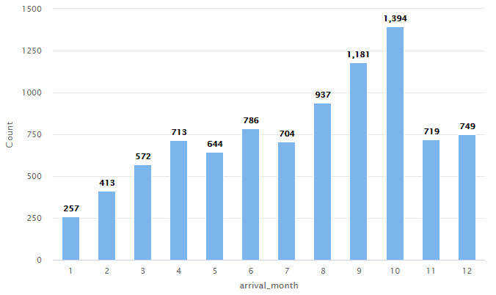
EDA - Univariate Analysis – Booking Months
Examining the bar count plot of Booking Months, we can make the following deductions:
Highest occupancy is October (10)
Highest occupancy month range is June (6) thru October (10), with a small decline occurring in July (7)
Peak booking months are August (8) thru October(10)
Lowest occupancy is in January (1)
Lowest occupancy month range is November (11) thru April (5)
January (1) and February (2) are the slowest months
There is a notable increase in April (4) from March (3) Is this due to school vacations?
Its unclear why there would be a drop off between June (6) and July (7).
Note: **We are only examining 2 months of data. It would be interesting to see if additional years of data would show a consistent trend
X-axis: Arrival month
Y-axis: Number of bookings
Description: Number of bookings per month

Slide 9
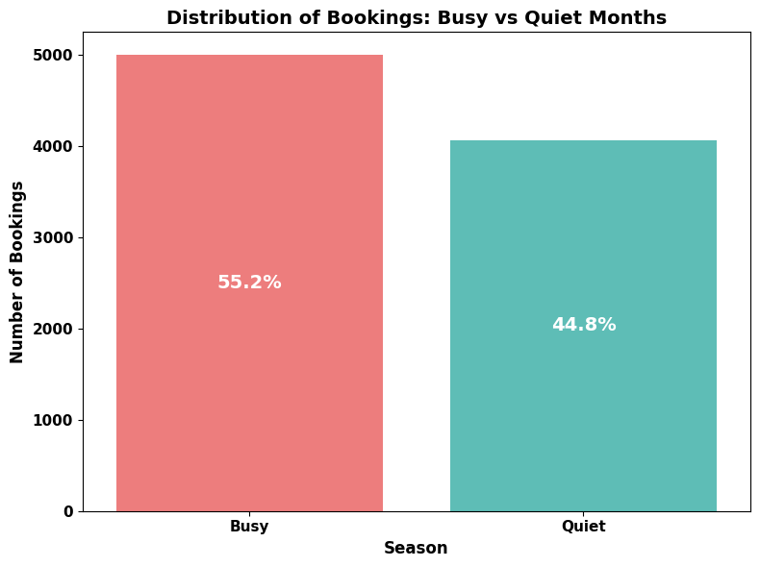
EDA - Booking Months
Dividing the Booking Months into Busy and Quiet seasons:
Highest occupancy is October (10)
Highest occupancy month range is June (6) thru October (10), with a small decline occurring in July (7)
Peak booking months are August (8) thru October(10)
Lowest occupancy is in January (1)
Lowest occupancy month range is November (11) thru April (5)
There is a notable increase in April (4) from March (3). Is this due to school vacations?
Its unclear why there would be a drop off between June (6) and July (7). **We are only examining 2 months of data. It would be interesting to see if additional years of data would show a consistent trend
Busy Months: June - October
Quiet Months: November - January

Slide 10
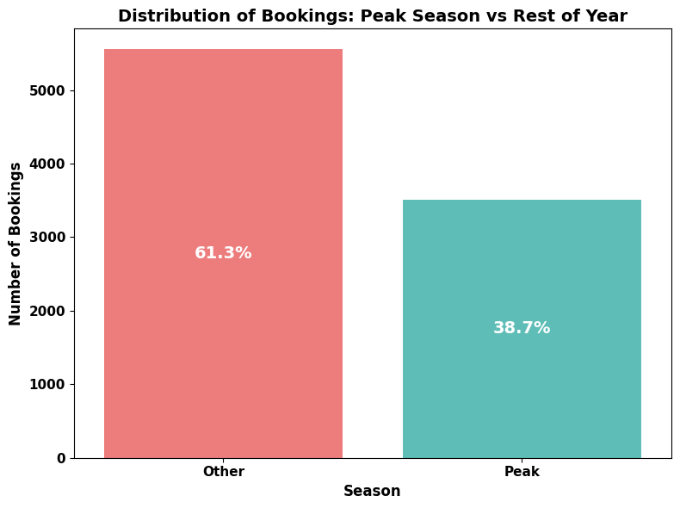
EDA - Booking Months
Dividing the Booking Months into Peak and Other seasons:
The peak booking season occurs between August (8) and October (10)
Those 3 months (August – October) account for almost 40% of the years bookings.
Peak Months: August - October
Rest of Year: November - July

Slide 11
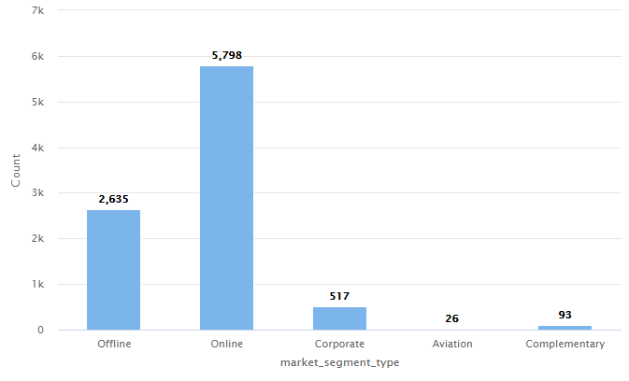
EDA - Univariate Analysis – Market Segment Type
Examining the histogram of booking market segments, we can make the following observations:
Highest market segment type is Online
2nd highest is Offline
Corporate ranks a distance 3rd
Aviation and Complementary are almost negligible
Complementary is free rooms. Unless it can be verified that comped rooms lead to future bookings, it would be advisable to keep this number low
X-axis: Market Segment Type
Y-axis: Number of customers
Description: Number of Bookings received in each market segment

Slide 12
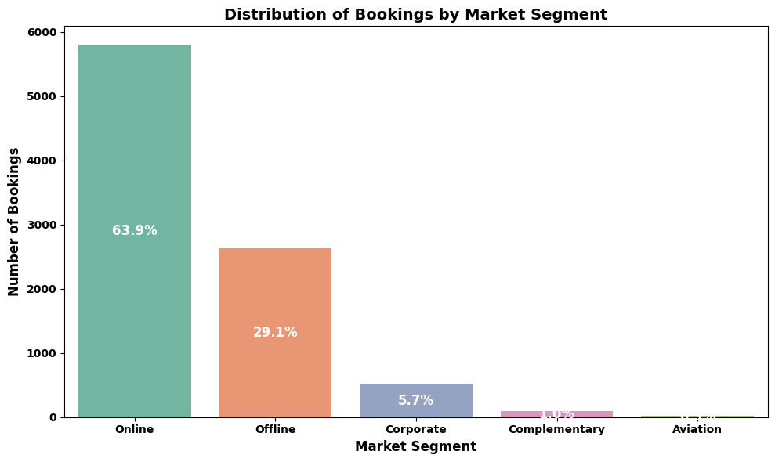
EDA - Market Segment Type
Examining Market Segment percentages relative to overall bookings:
Online booking is by far the strongest market segment
Offline still accounts for around 30% of all bookings
Corporate ranks a distance 3rd
Aviation accounts for less than 1% of the bookings
X-axis: Market Segment Type
Y-axis: Number of customers
Description: Percentages of Bookings received in each market segment

Slide 13
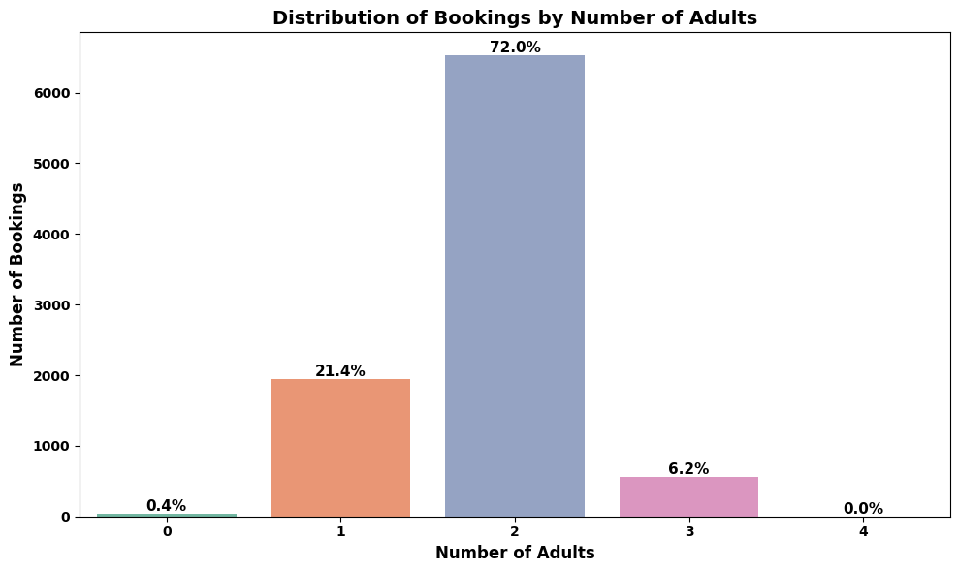
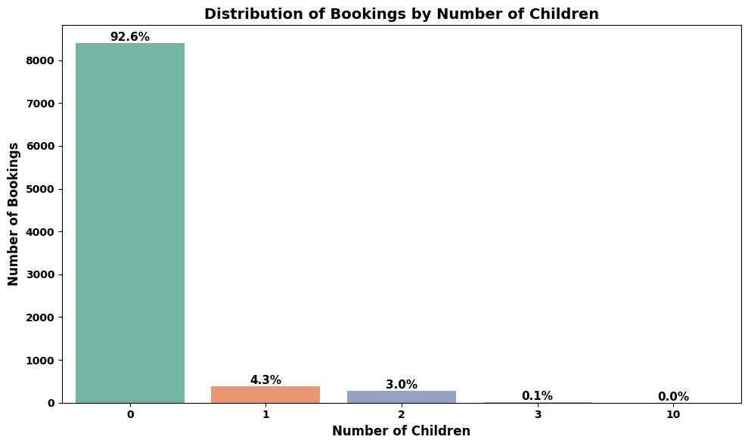
EDA – Univariate Analysis - Number of Guests
Examining Number of Guests we see:
The number of Adult Guests is Normal Distribution
Most rooms (72%) have 2 adults
25% of rooms have a single adult occupant
The number of Children is Left-Skew Distribution
A surprisingly number of rooms have no children (93%)
X-axis: Number of occupants (adults/children)
Y-axis: Number of bookings (frequency count)
Description: Distribution of bookings by occupancy level

Slide 14
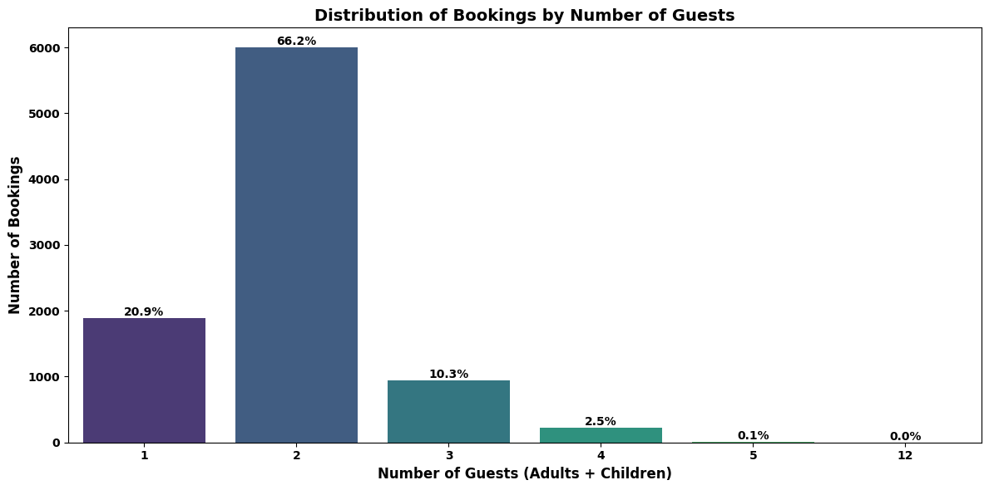
EDA – Number of Guests (Total Guests)
Examining Booking Lead Times we see:
The Booking Lead Time data has a definite right skewed distribution
A majority of the bookings occur 100 days or less ahead of the customer’s arrival
X-axis: Number of total occupants (adults and children)
Y-axis: Number of bookings (frequency count)
Description: Distribution of bookings by occupancy level

Slide 15
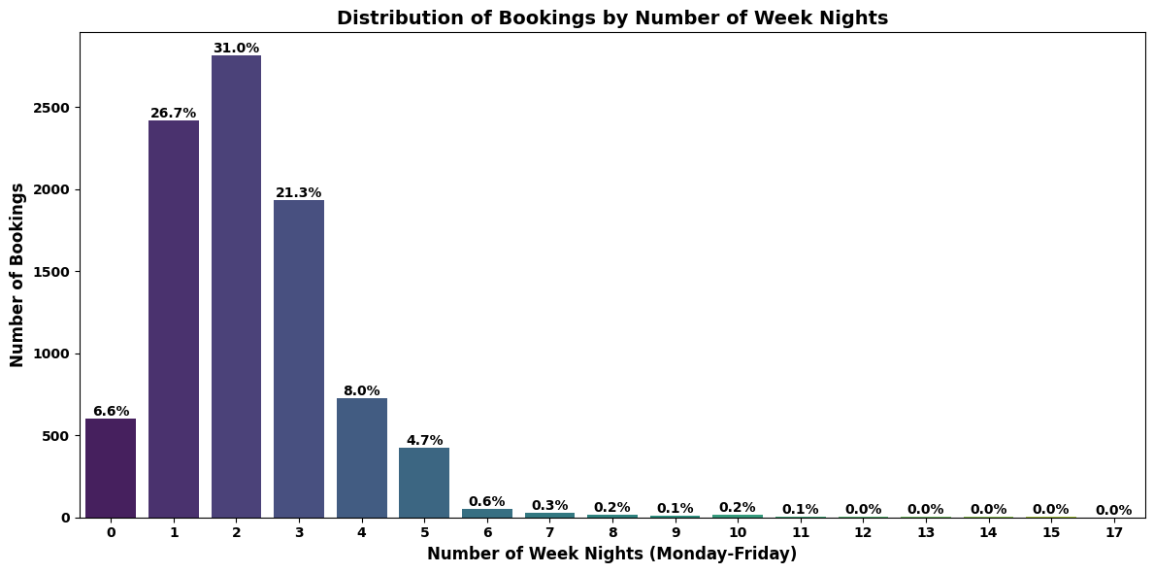
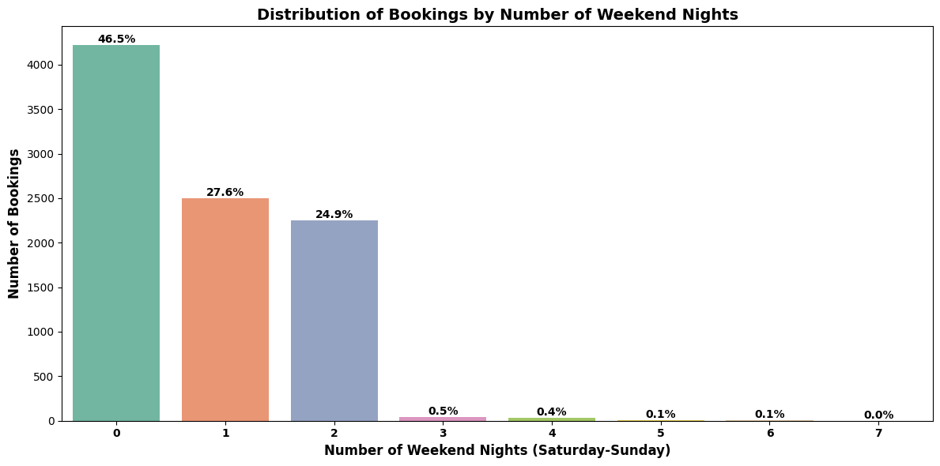
EDA – Univariate Analysis - Number of Days Booked
Examining Number of Days Booked we see:
The Weekday Bookings plot looks like Normal Distribution with a Right-Skew
The Weekend Bookings looks like a Right-Skew Distribution
Zero (0)days booked indicate the customer booked only weekdays or weekends for their stay
Most of the bookings had at least 1 weekday night included
Roughly ½ the bookings had 2 weekend nights
X-axis: Number of nights booked (weekday/weekend)
Y-axis: Number of bookings (frequency count)
Description: Distribution of bookings by length of stay

Slide 16
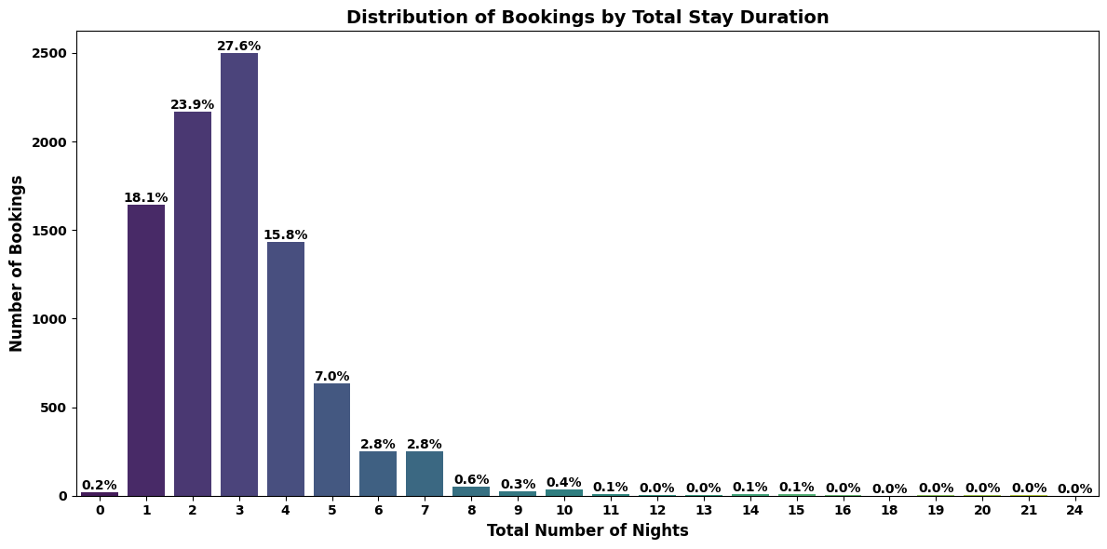
EDA –Number of Total Days Booked
Examining Total Number of Days Booked we see:
The total number of Booking Nights plot looks like Normal Distribution with a Right-Skew
The total number of nights looks like a Right-Skew Distribution
Few clients book more than 7 days
Zero (0)days booked looks like it could be a data error
Most of the bookings had at least 1 weekday night included
X-axis: Total number of occupants (adults and children)
Y-axis: Number of bookings (frequency count)
Description: Distribution of bookings by occupancy level

Slide 17
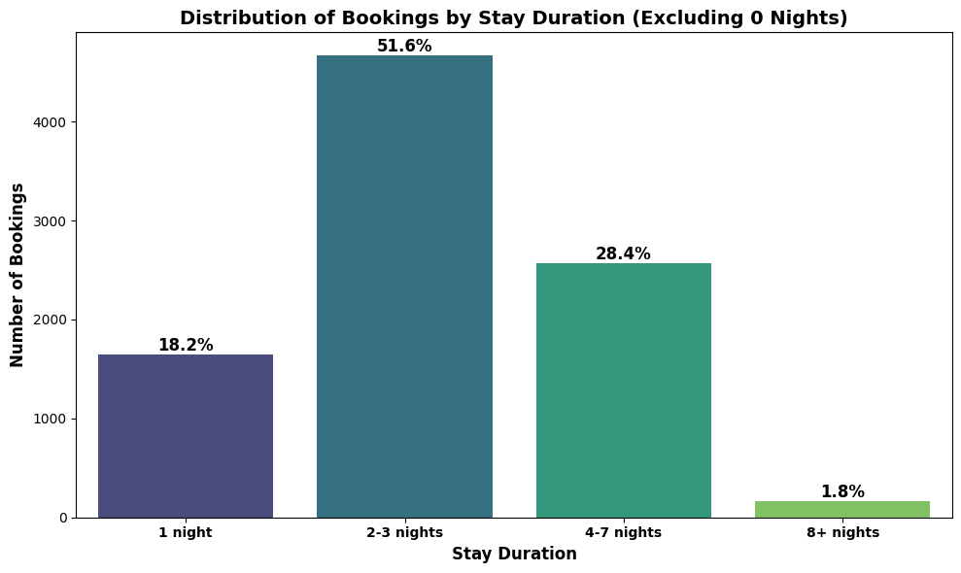
EDA –Number of Total Days Booked
Examining Total Number of Days Booked we see:
By binning the data, we get a slightly different view
This looks much more like a normal distribution
From this, we can see that almost 80% of the bookings are for between 2 and 7 nights
X-axis: Total number of occupants (adults and children)
Y-axis: Number of bookings (frequency count)
Description: Distribution of bookings by occupancy level

Slide 18
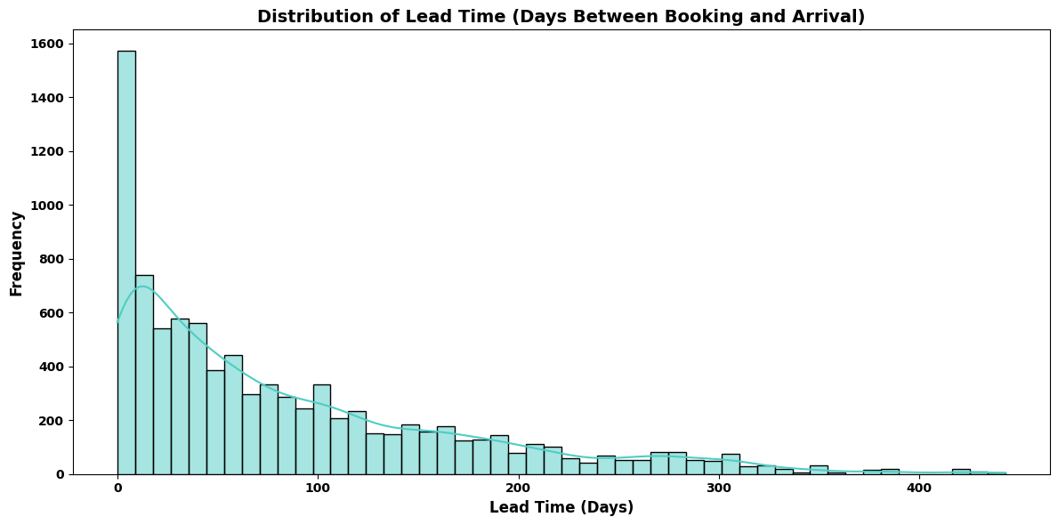
EDA – Univariate Analysis - Booking Lead Times
Examining Booking Lead Times we see:
The Booking Lead Time data has a definite right skewed distribution
A majority of the bookings occur 100 days or less ahead of the customer’s arrival
X-axis: Booking Lead time in days
Y-axis: Instance count of instances of days
Description: Count of the number if instances days clients booked in advance

Slide 19
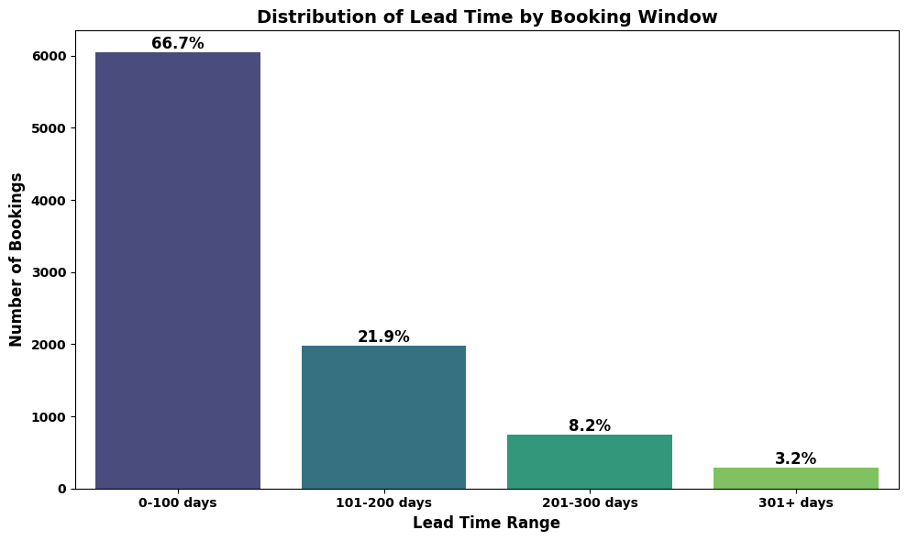
EDA – Booking Lead Times
Examining Booking Lead Times continued:
Binning and plotting the percentages of the Booking Lead Time data reiterates the right skewed distribution
2/3rds of clients book within 100 days of their arrival date
A small percentage (11%) book more than 200 days in advance
X-axis: Number of days client booked in advance in bins
Y-axis: Count of number of
Description: Count of the number if instances of previous cancellation/non-cancellation events

Slide 20
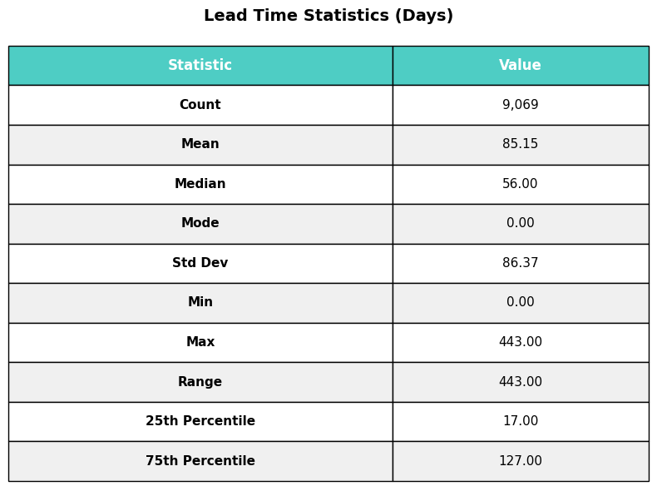
EDA –Booking Lead Times
Examining Booking Lead Times continued:
Binning and plotting the percentages of the Booking Lead Time data reiterates the right skewed distribution
2/3rds of clients book within 100 days of their arrival date
A small percentage (11%) book more than 200 days in advance

Slide 21
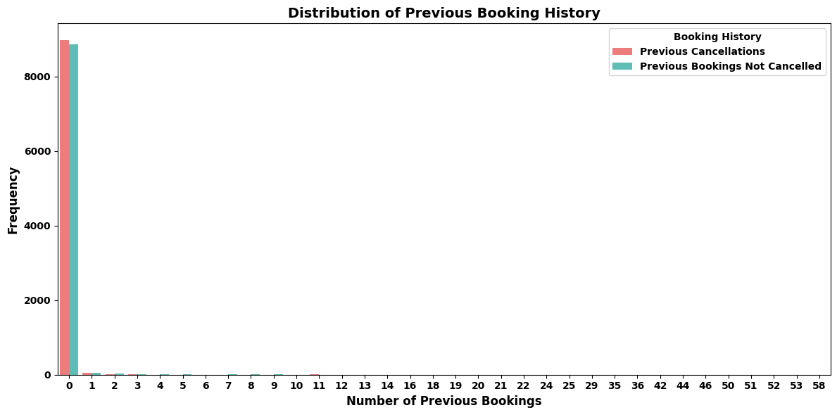
EDA – Univariate Analysis - Previous Booking History
Examining Previous Bookings continued:
Binning the Previous Booking data into Canceled/Uncancelled and plotting the percentages reiterates the tight right skewed distribution
2/3rds of clients book within 100 days of their arrival date
A small percentage (11%) book more than 200 days in advance
X-axis: Number of instances of previous cancellation/non-cancellations
Y-axis: Count of number of cancellation/non-cancellation instances
Description: Count of the number if instances of previous cancellation/non-cancellation events

Slide 22
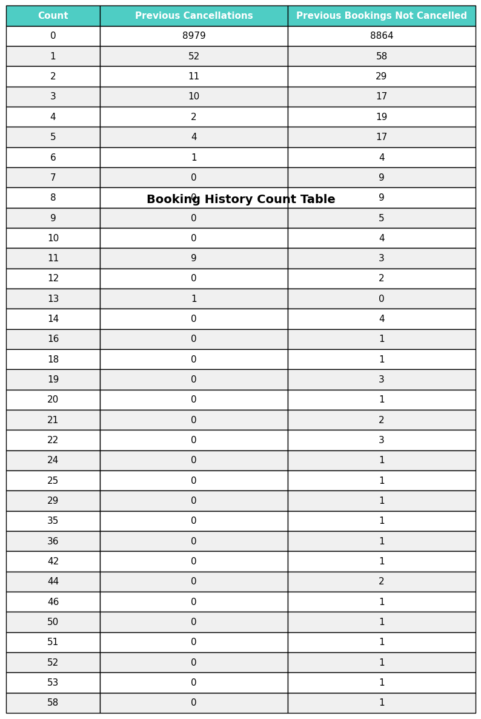
EDA – Previous Booking History
Examining Previous Cancellations continued:
Looking at the supplied matrix data, it appears that Previous Cancellations are minimal, especially when comparing against the number of clients that did not have Previous Cancellations

Slide 23
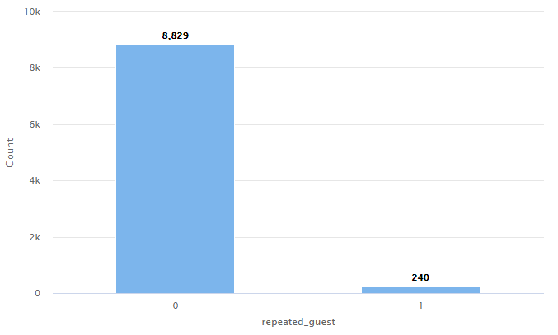
EDA - Univariate Analysis – Repeat Customers
Examining the histogram of repeat customer business, we can deduce the following:
Most of the customers at the hotel are 1st time bookings
There is very little (almost negligble) repeat business
This might indicate that the hotel is good at drawing initial clients but poor at following through by reaching out to previous customers
This also might speak to the level of quality of stay and service as when customers have a less than positive experience, they are not likely to rebook in the future
Its unclear to what degree guests having a potentially negative experience affects the bookings initialized by word of mouth
X-axis: Repeated guests
Y-axis: Number of Guests
Description: Customers who have visited the hotel more than once vs customers who have visited the hotel only once

Slide 24
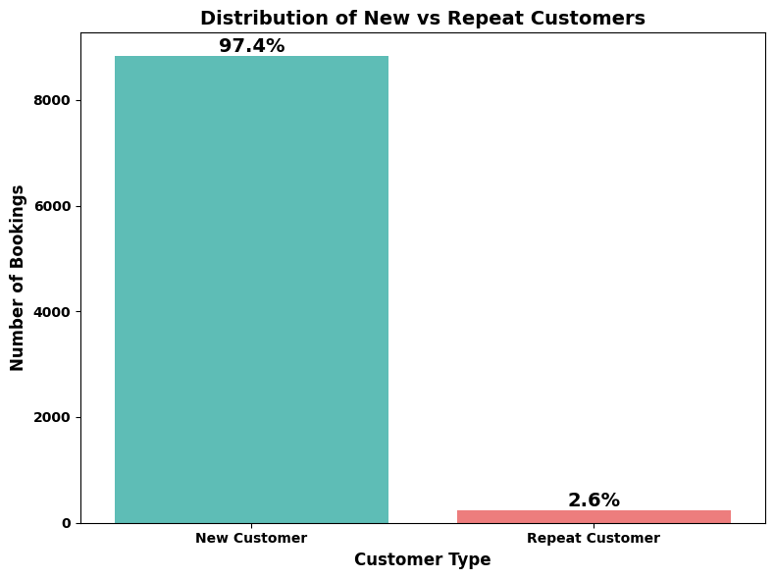
EDA - Repeat Customers
Examining Repeat Customers percentages relative to overall bookings:
Roughly 98% of the bookings are from new customers
Repeat customers make up less than 3% of the bookings
Those are incredibly skewed results in favor of 1st time clients
This is especially alarming for an industry where reputation (from word of mouth, online reviews) is important in sustaining a profitable business
The hotel really has to take a step back and examine it’s operations, cultural enviornment and guest experience
X-axis: Repeated guests
Y-axis: Number of Guests
Description: Percentage of customers who have visited the hotel more than once vs customers who have visited the hotel only once

Slide 25
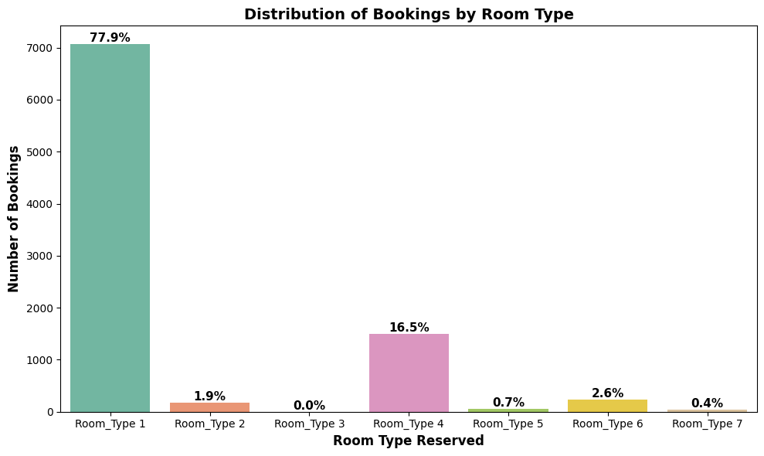
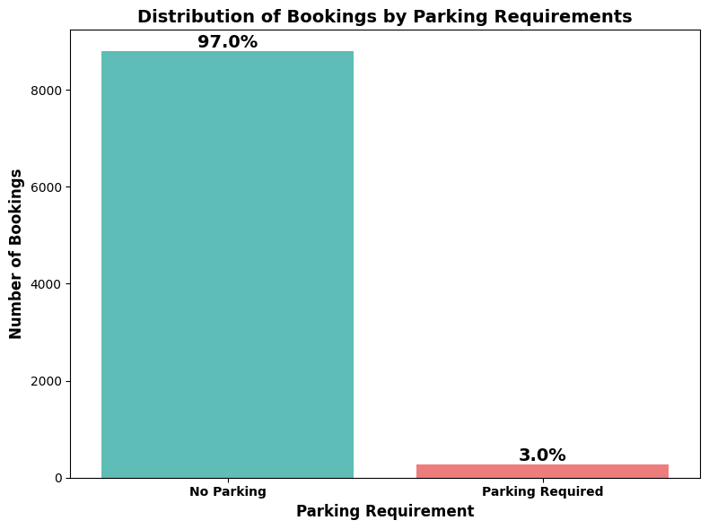
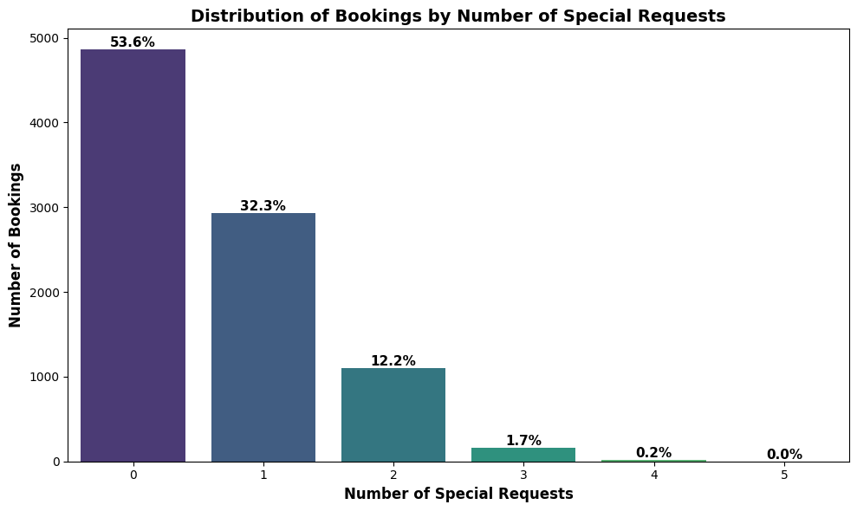
EDA - Univariate Analysis – Additonal Features
Examining remaining features:
Room Type generally looks like a right-skewed distribution
Most people book either Room Type 1 (79%) or Room Type 4 (16%)
Parking Requirements - Almost all clients do indicate a preference for required parking
Special Requests is a right-skewed distribution
Over ½ the bookings (54%) have no special requests
45% of the bookings have 1-2 special requests

Slide 26
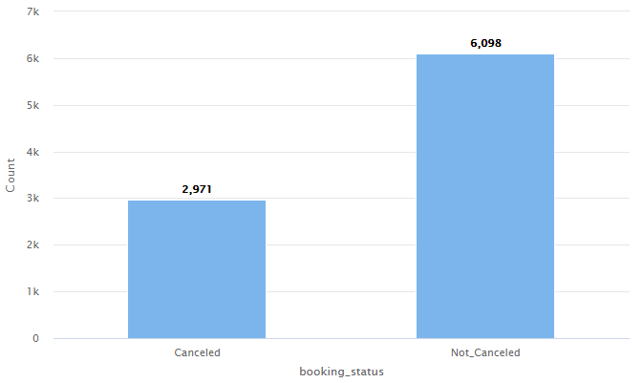
EDA - Univariate Analysis - Cancellations
Examining the histogram of booking status, we can make the following observations:
What we are really looking at here is the labeled net effect (Cancelled, Not Cancelled) which are contributed to by the other data features
More bookings are Not Cancelled compared to Cancelled by a ratio of roughly 2 to 1
That is a high number of cancellations that the business has to deal with
Its not clear from this graph whether that ratio is consistent across the 2 years of data, or whether an event (weather, covid, economic) affected the results one of the years which would unduely sway the results
X-axis: Booking status
Y-axis: Number of bookings
Description: Count of bookings that are Cancelled v/s Not Cancelled

Slide 27
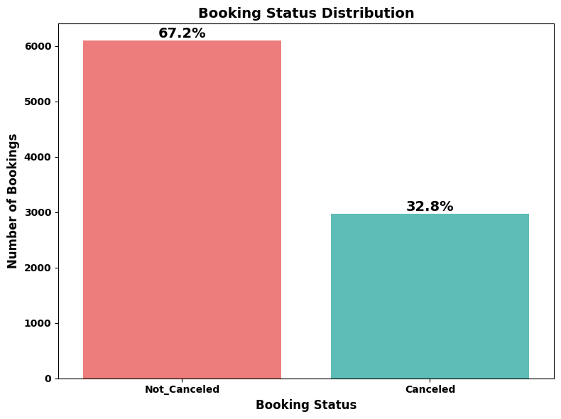
EDA – Cancellations
Examining Booking Status percentages relative to overall bookings:
Roughly 70% of the bookings are successful and not cancelled
30%-ish cancellation rate is a very high rate of cancellation
The high percentage of cancellations is huge cost for the business to absorb in terms of rebooking costs
It’s not clear from the data as to how many of those cancellations end up getting successfully rebooked and at what room rate
It would be interesting the data set included more details surrounding booking prices and rebooking percentages to more accurately understand the costs
X-axis: Booking status
Y-axis: Number of bookings
Description: Percentage of bookings that are Cancelled v/s Not Cancelled

Slide 28
Results EDA - Univariate Analysis
Key Findings - Univariate Analysis
Booking Patterns
  Peak season: August-October accounts for ~40% of annual bookings
  Slowest months: January-February show lowest occupancy
  Seasonal split: Busy season (June-October) vs. Quiet season (remaining months)
  Booking behavior: 2/3 of customers book within 100 days; only 11% book 200+ days in advance
  Stay duration: ~80% of bookings are for 2-7 nights; very few extended stays
Guest Demographics
  Party size: 72% of rooms have 2 adults; 25% single occupancy
  Limited Family Booking: 93% of bookings have no children
  Guest type: Normal distribution for adults; left-skewed for children

Slide 29
Results EDA - Univariate Analysis
Market Segments
  Online dominates: Largest booking channel by significant margin
  Offline remains strong: ~30% of total bookings, but could decrease as older/less
  than tech savvy tech clients age out
  Corporate distant third: Limited corporate segment penetration
  Aviation negligible: Less than 1% of bookings
Room Preferences and Requests
  Room concentration: 79% book Room Type 1; 16% book Room Type 4
  Parking demand: Nearly all clients do not require parking
  Special requests: 54% have no requests; 45% make 1-2 requests
Booking Lead Time
  High variability: Standard deviation (86 days) nearly equals mean (85 days)
  Same-day bookings: Mode of 0 days indicates frequent last-minute reservations
  Unpredictable patterns: Wide range (0-443 days) makes forecasting difficult

Slide 30
Results EDA - Univariate Analysis
Customer Retention Problem
  98% new customers: Nearly all bookings are first-time guests
  <3% repeat business: Alarmingly low customer loyalty
  Service quality concern: Poor retention suggests negative guest experiences
  Reputation risk: Low repeat rates may indicate poor reviews via online reviews and word-of-mouth
Cancellation Crisis?
  30% cancellation rate: Extremely high and costly for operations
  2:1 ratio: Roughly 2 successful bookings for every 1 cancellation
  Revenue impact: Significant rebooking costs and potential revenue loss

Slide 31
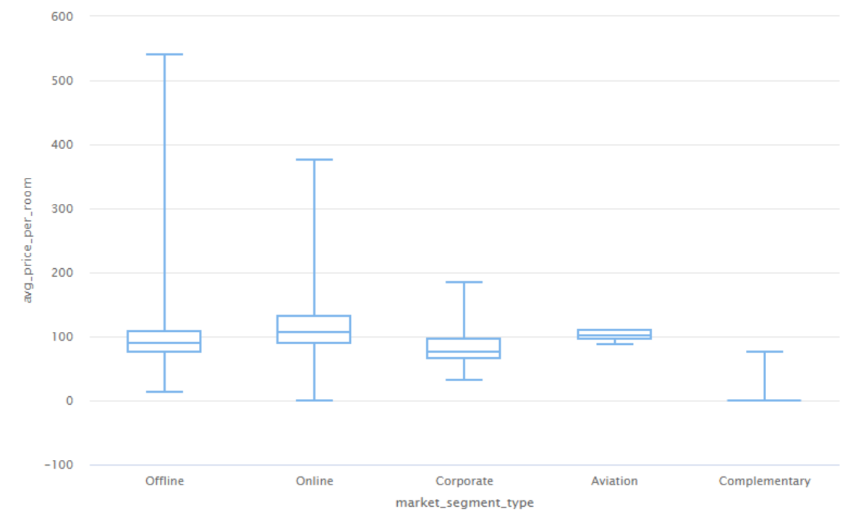
EDA - Bivariate Analysis – Market Segment Price Variations
Examining Market Segments and how they relate to Price Variations:
Online has the highest median price ($110-$115)
Online has a pretty wide price variance, maxing out at just under $400
Aviation has 2nd highest median ($100-$100), but avaition bookings are the smallest of the hotel’s bookings
Offline is next with a median of ($95-$100)
Offline has the highest variability spanning between ~$90 - $550
Corporate bookings have the next highest median (~$95), once again it is a smaller share of segments
Complementary does not directly figure into the hotel’s revenue stream
It could be profitability factor if the hotel comps out more higher priced rooms than it should
X-axis: Market segment type
Y-axis: Average price per room
Description: Price per room across various market segments

Slide 32
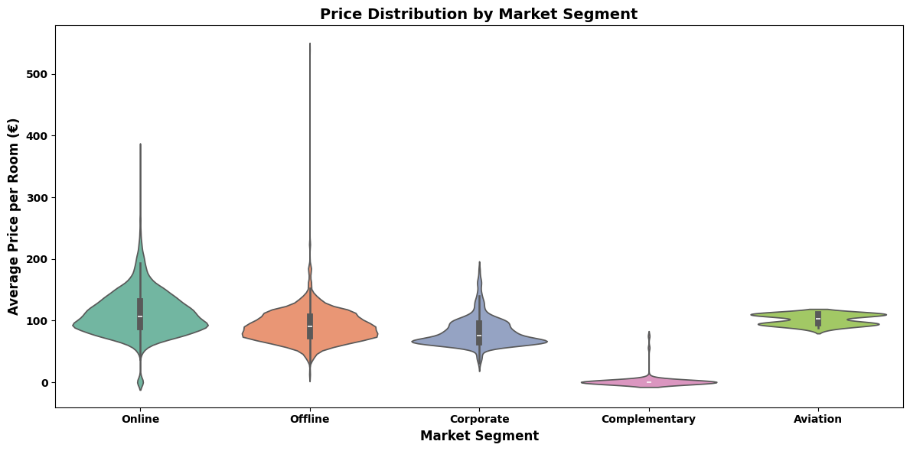
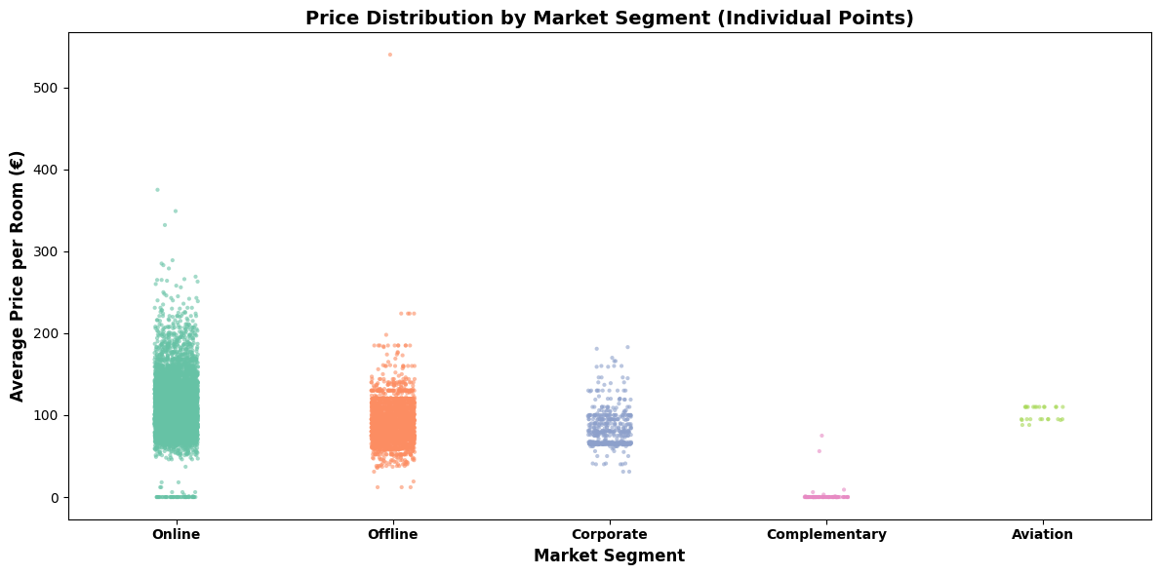
EDA – Market Segment Price Variations
Explanations for how Market Segments correlate to Room Prices:
These plots represent a different visualization of the Market Segment/Room Price relationship:
Online Booking:
  Has the higher prices
  It should be the most profitable
    Accounts for highest percentage of bookings
    Company cost to book rooms online is cheaper and less labor intensive than direct contact
Offline Booking:
  Widest price variance suggests price inconsistencies across sales channels
  Suggest wide range of customer types: from budget conscious to premium clientele (where price isn’t an issue)
  It is the most unpredictable and least optimized segment
Corporate Booking:
  A smaller price range indicates probable use of negotiated (corporate rates)
Aviation Booking:
  Since the prices are tightly clustered, it might indicate use of standardized/fixed (reduced) rates
X-axis: Market segment type
Y-axis: Average price per room
Description: Price per room across various market segments

Slide 33
EDA - Market Segment Price Variations
Strategies for optimizing Price Variations across market segments:
Online Booking/Offline Booking:
  Real time price adjustment to keep room prices competitive with competition
  Rate parity across channels and online presentations
  Set a price floor where selling a room below a prespecified value is not deemed profitable
  Bundle air travel and hotel stay as packages
Online Booking:
  Add surge pricing during peak seasons/special events
  Show real time room inventory levels to motivate customers to complete booking process
  Automated sales email compaigns and measured increased advertising
  Make sure to have clearly visible “special requests” as part the online experience
Offline Booking:
  Standardized pricing strategies
  Restructured commission plans and incentives for travel agents
  Better training for agents
Corporate Booking:
  Volume based discounts
  Tiered room packages and add ons
  Business development – campaign to reach out to new potential clients (including local companies)
  Offer corporate discounts to frequent guests for private stays
Aviation Booking:
  Re-evaluate and adjust contract rates according to market conditions and inflation
  Target new/additional airlines
  Add airline crew specific amenities
  Crew member personal stay discounts

Slide 34
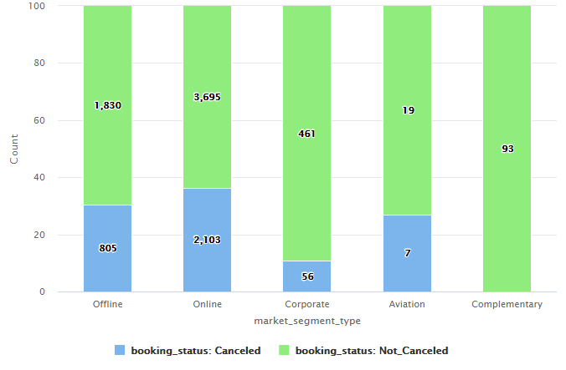
EDA - Bivariate Analysis – Booking Status and Market Segments
Examining Market Segments and how they relate to Cancelled Bookings:
Online and Offline booking result in the highest number of cancellation both in total count and as percentages relative to their specific segments
Corporate and Aviation booking have fewer overall cancellations in terms of count and segment percentages
Complementary bookings have no cancellations because they are free (no cost to the customer)
X-axis: Market Segment type
Y-axis: Number of bookings
Description: Number of bookings that are cancelled vs not cancelled across various market segments

Slide 35
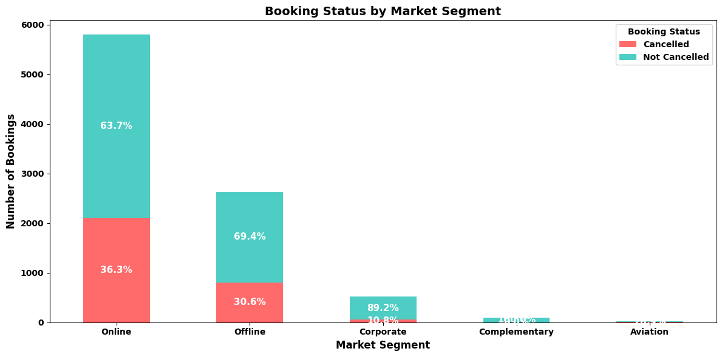
EDA – Effects of Market Segments
Explainations for how Market Segments correlate to Cancelled Bookings:
Online and Offline booking accounts for 97% of cancellations
Roughly 30% of all Online and Offline bookings get cancelled
Online Booking:
  Majority of people today book online
  Easy to book online, easy to cancel online
Offline Booking:
  Although still substantial, fewer and fewer people are booking offline (phone/travel agencies)
  Not as convenient as online cancellation, but still easy
Corporate Booking:
  Customers that make special requests are more engaged planners
  They understand what they want and are less impulsive
Aviation Booking:
  Directly tied to airline cancellations
  Likelyhood of Aviation booking cancellation is directly related to whether a flight gets cancelled or not
X-axis: Market Segment type
Y-axis: Number of cancelled/non-cancelled bookings (percentages)
Description: Number of bookings that are cancelled vs not cancelled as percentages across the various market segments

Slide 36
EDA - Effects of Market Segments
Strategies for minimizing cancellation risks associated with market segments:
Online Booking/Offline Booking:
  Progressive cancellation penalties as booking nears check in date
  Offer credit instead of refunding booking cost
  Loyalty program for completed bookings
  Follow up confirmation (emails, phone calls)
  Regular automated reminders
  Post booking engagement – emails/mailers about local attractions
Online Booking:
  Make the actual online cancellation process more difficult (add steps)
  Make “Special Requests” a prominent part of the online booking experience
  Have a deliberate multi-step online confirmation process
  Offer free cancellation with 1st 24 hours after booking to incentivize uncertain customers to cancel early
  Ability to rebook/modify dates instead of outright cancelling
  Clearly display the cancellation policy and ask for confirmation
Offline Booking:
  Bonuses to travel agents with lowest cancellation rate
  Better training – help agents identify higher risk bookings, direct telephone follow up
  Warning system that alerts agents to high risk bookings
Corporate Booking:
  Save client profiles (preferences, room styles, special requests)
  VIP treatment for top executives
  Maintain direct contact with existing corporate clients
  Offer corporate discounts to frequent guests
Aviation Booking:
  Real time communications/alert system for early notification of cancellations so rooms will have more time to be rebooked
  Reward airlines that minimize short notice cancellations
  Tiered partnership/rewards programs

Slide 37
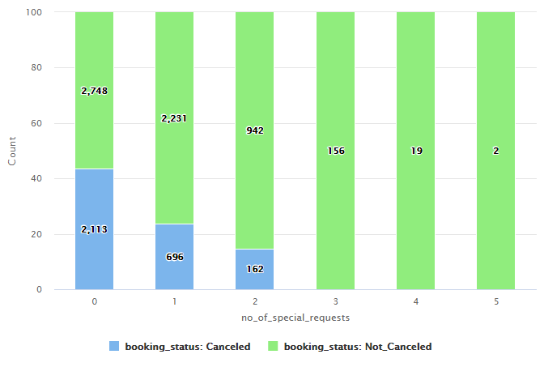
EDA - Bivariate Analysis - Effects of Special Requests
Examining Special Requests and how they relate to Cancelled Bookings:
Examining the existing plot, it’s easy to identify an inversely proportional relationship.
As the number of special requests increases, the number of cancelled bookings decreases
That relationship is consistently strong across all request levels
Special Requests are a strong indicator of reservation commitment
Zero requests is a clear red flag for a risk of cancellation
A subsequent plot on the following page compares the percentage of cancellations/non-cancellations with special request

Slide 38
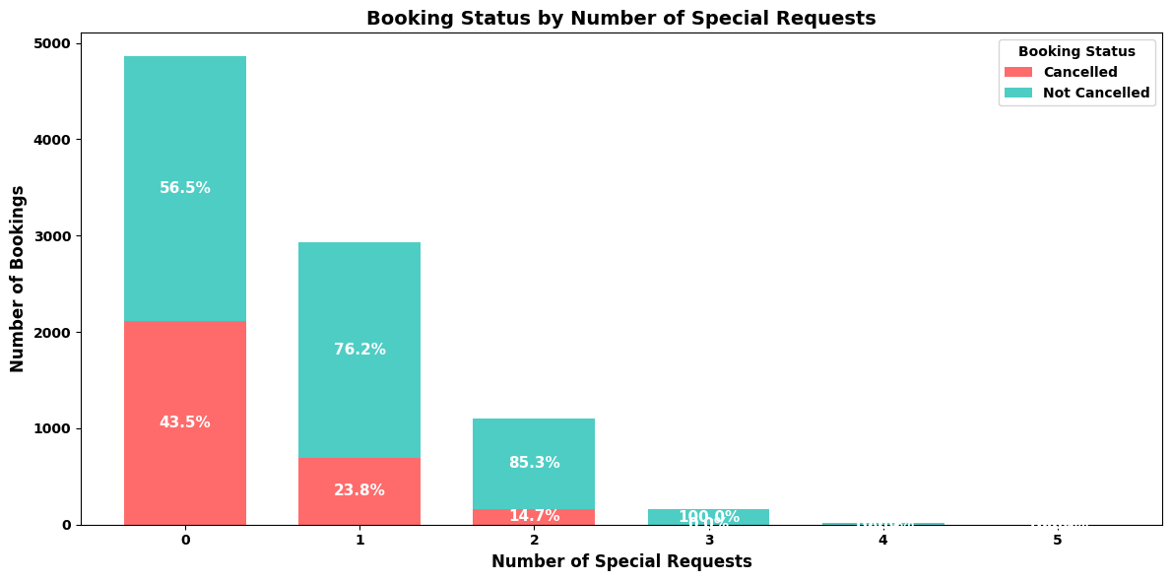
EDA - Effects of Special Requests
Explainations for how Special Requests correlate to decreased Cancelled Bookings:
Greater Personal Commitment:
  Clients who make special requests are active in their trip planning
  The time it takes to do so indicates a higher level of commitment
Trip Purpose:
  Special Requests can be associated with events such as weddings, anniversaries, business meetings – events less likley to be cancelled
  The time it takes to do so indicates higher trip commitment
Client Engagement:
  Customers that make special requests are more engaged planners
  They understand what they want and are less impulsive
Booking Timeline:
  They are more likely to have booked in advance
  Their hotel stay is combined with other trip elements – flights, events and are less likely to be cancelled
Increased Personal Investment:
  Business/Frequent travellers often make more requests because they know what they want/like
  Business/Frequent travellers are less likely to cancel
  Casual/First Time guests are likely to make fewer requests and more more likely to cancel
X-axis: Number of Special Requests
Y-axis: Number of cancellations/non-cancellations (percentages)
Description: Compares the special requests to the overall percentage of cancellations/non-cancellations at each request level

Slide 39
EDA - Effects of Special Requests
Strategies for minimizing cancellation risks associated with decreased special requests:
Promote/Encourage addition of Special Requests during the booking process:
  Add prompts for special requests during the booking process
  Offer bundled special requests at a discount
Stricter cancellation policies for zero(0) request bookings:
  They are at a higher risk and are more likely to be cancelled
  Try to mitigate risk by automated follow up emails and booking confirmation
More flexible cancellation policies for mulit-request bookings
  They are lower risk and the booking is much more likely to be honoured
Lower initial deposits for multi-request bookings:
  They are more likely to have booked in advance
  Their hotel stay is combined with other trip elements – flights, events and are less likely to be cancelled
Save premium priced rooms for travellers with a higher number of requests
Dynamic Pricing:
  Incetivise by adjusting prices based on the number of special requests
Overbook rooms to compensate for the anticpated loss due to 0 request cancellations
Requirement prepayment for zero request rooms

Slide 40
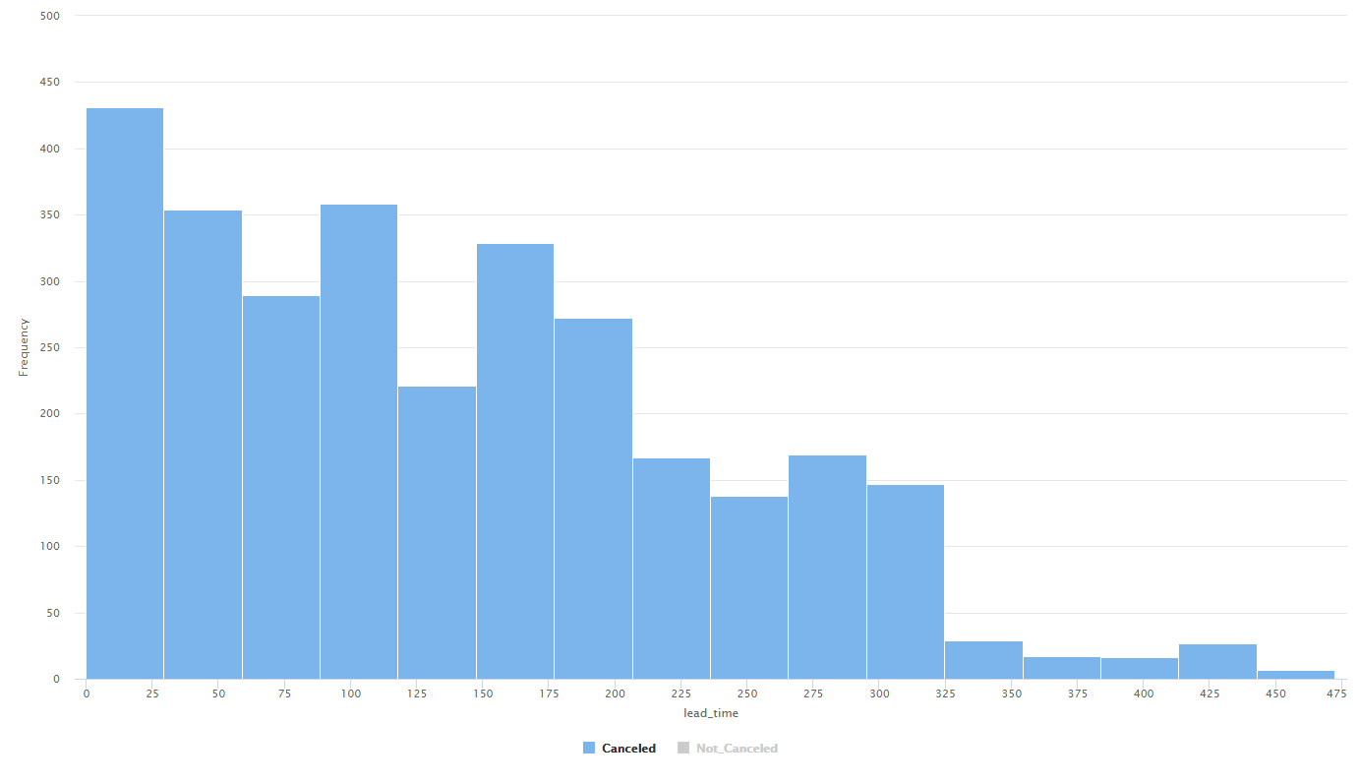
EDA - Bivariate Analysis – Effects of Booking Lead Times
Examining Booking Lead Times and how they relate to Cancelled Bookings:
Shorter Book Lead Time results in higher number of cancellations
As the lead time increases, the number of cancellations decrease (this could be related to the fact the number of bookings decrease as the lead time increases)
The distribution has a definite although uneven right-skew
X-axis: Lead time
Y-axis: Number of bookings
Description: Lead time of the bookings that were cancelled

Slide 41
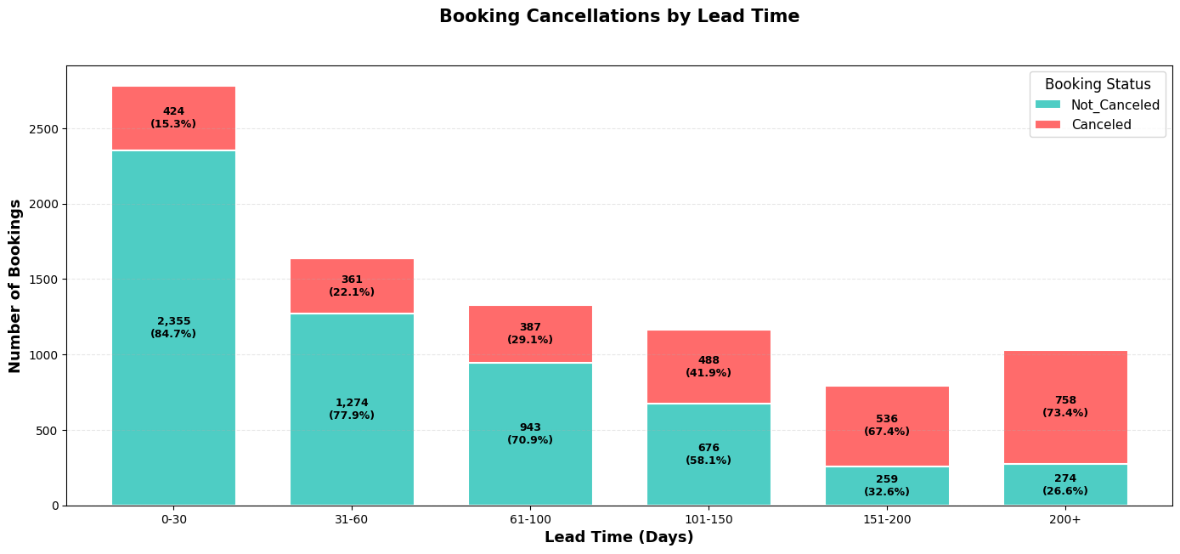
EDA - Effects of Booking Lead Times
Explanations for how Booking Lead Times correlate to increased Cancelled Bookings:
Perceived Timeline:
  Trips booked too far in the future don’t feel as “concrete”
  Shorter termed bookings feel more real and build excitement
  Easier to cancel future trip booked far in future than one that is imminent
Commitment Levels:
  Shorter lead times are more delierate actions – “decision’s been made”
  Longer lead times lead to “book now, make final decision later”
  Bookings made on impulse too far in the future are often regretted
  Life changes over longer lead times can lead to cancellations
Client Engagement:
  With shorter lead times, clients are excited and actively planning
  Longer lead times, customers tend to forget about bookings
  When not actively engaged, clients attention fades over time
Other Factors:
  Far future bookings allow clients to find better deals on other properties
  Inadequate cancellation policies encourage consumers to competitive shop without fear of repercussions
X-axis: Number Days of Booking Lead Time
Y-axis: Number of cancellations/non-cancellations (percentages)
Description: Compares the dayd of Lead Time to the overall percentage of cancellations/non-cancellations at each request level

Slide 42
EDA - Effects of Booking Lead Times
Strategies for minimizing cancellation risks related with Booking Lead Times:
Promote/Encourage addition of Special Requests during the booking process:
  Add prompts for special requests during the booking process
  Offer bundled special requests at a discount
Stricter cancellation policies for zero(0) request bookings:
  They are at a higher risk and are more likely to be cancelled
  Try to mitigate risk by automated follow up emails and booking confirmation
More flexible cancellation policies for mulit-request bookings
  They are lower risk and the booking is much more likely to be honoured
Lower initial deposits for multi-request bookings:
  They are more likely to have booked in advance
  Their hotel stay is combined with other tip elements – flights, events and are less likely to be cancelled
Save premium priced rooms for travellers with a higher number of requests
Dynamic Pricing:
  Incetivise by adjusting prices based on the number of special requests
Overbook rooms to compensate for the anticpated loss due to 0 request cancellations
Requirement prepayment for zero request rooms

Slide 43
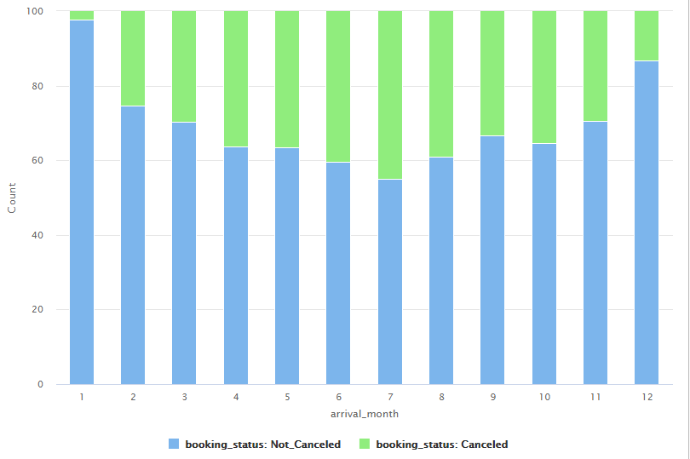
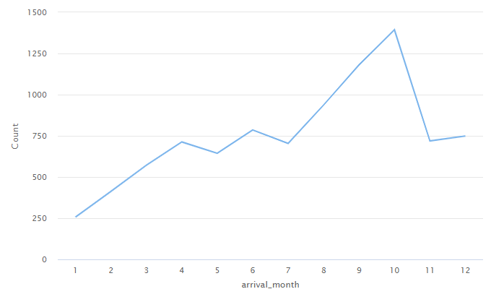
EDA - Bivariate Analysis – Effects of Check-in Month
Examining Check-in Month and how it relates to Cancelled Bookings:
Summer through early fall is the peak travel season with the highest number of arrivals
Cancellations are noticeably increased during this period
July has the highest number of cancellations
The offseason (November through March) has fewer cancellations
January has the lowest cancellation rate
A left-skewed (if not somewhat normalized) distribution, but in the case the distribution would change depending on which month we start our plots with

Slide 44
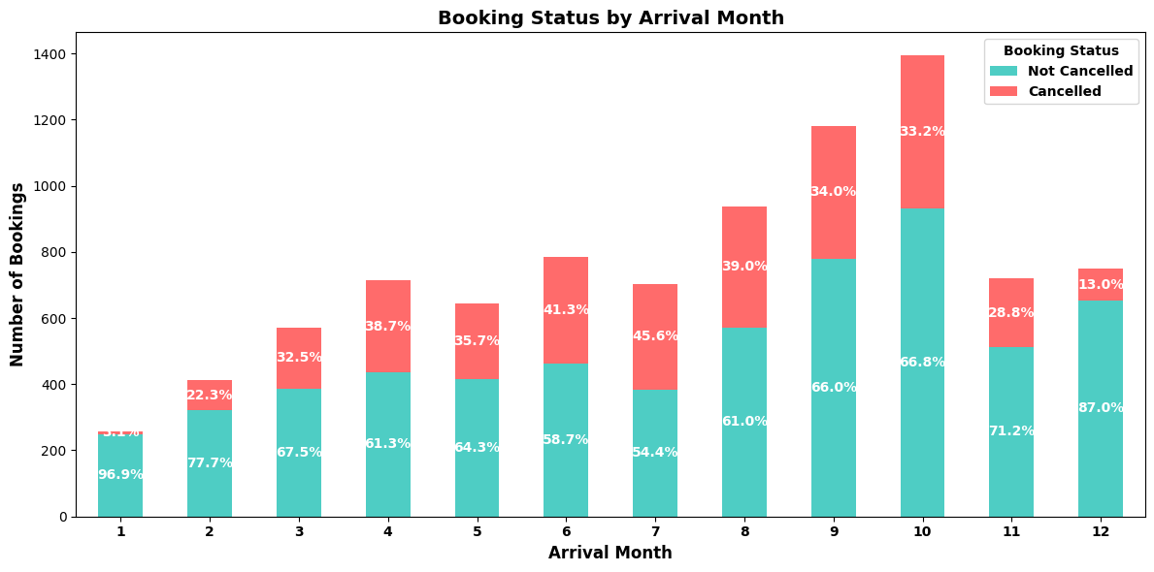
EDA - Effects of Check-in Month
Explanations for how Check-in Month correlates to Cancelled Bookings:
This plot provides a clearer picture showing the bookings per month along with a stacked view of the cancelled/non-cancelled bookings and their percentages
Base on this view we can see that June – August have the highest percentage of calculations along with April (is that a school vacation month?)
Higher Cancellations in Summer/Fall:
  Peak season booked far in advance – cancellation more likely
  The time it takes to do so indicates a higher level of commitment
  Vacaton plans often change from the time they are first booked
  People will often shop around for better deals. If suitable cancellation penalties don’t exist, they will book the better deals
Lower Cancellations in Winter:
  Holiday/Family plans – are often firmer plans (Christmas at grandmas)
  Bookings are made closer to travel dates
  Lower prices/more deals in the off season
  Increased relative percentage of business/corporate bookings which are generally more reliable
X-axis: Arrival (Check-in) month
Y-axis: Number of cancellations/non-cancellations (percentages)
Description: Compares the client arrival month to the overall percentage of cancellations/non-cancellations at each request level

Slide 45
EDA - Effects of Booking Month
Strategies for minimizing cancellation risks related with Booking Month:
Peak Season (June – October):[Including April as school vacation month]
  Stricter cancellation policies – reduce window for free cancellations
  Shorten the booking window – release rooms with less lead time for booking
  Non-refundable deposits
  Automated customer follow up at predefined intervals before arrival date
  Strategic overbooking – overbook rooms with the knowledge of the predicted cancellation rates
Offseason (November – March):
  Creative all inclusive vacation stay packages (partner with other local businesses?)
  Target more reliable booking segments (corporate, repeat clients)
  Increase (bonus) customer loyalty programs
  Lower room deposit requirements
  Extended stay discounts
  Last minute sales/deals to appeal to the more spontaneous travellers

Slide 46
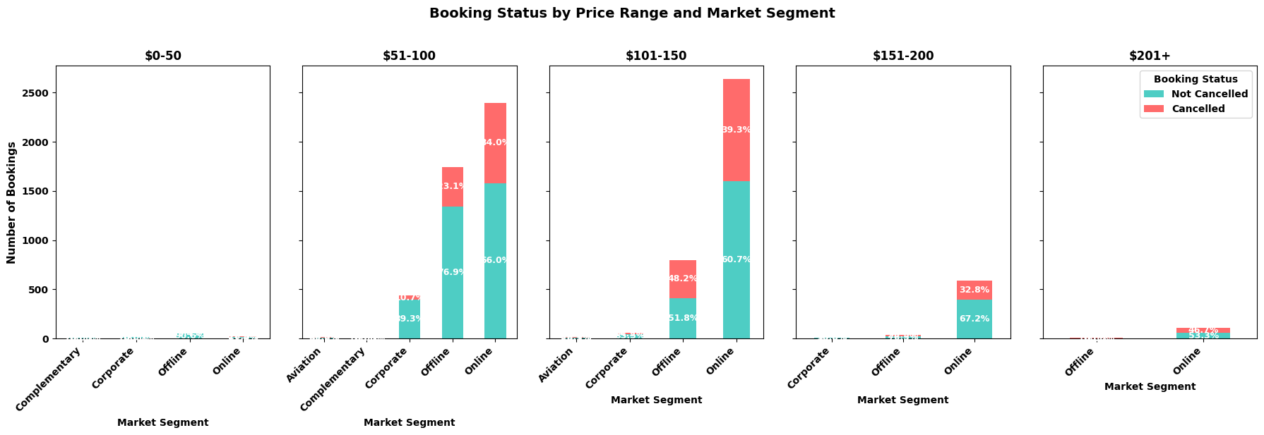
EDA - Multivariate Analysis – Comparing Booking Status
by Price Distribution and Market Segment
Examine how combined features of Price Distribution and Market Segment relate to Cancelled Bookings:
The following plots illustrate the cancellation/non-cancellations by market segments across different ranges of room costs
Most bookings occur in the $51 - $150 price range in the Online/Offline market segments
Consequently most cancellations occur in these ranges as well
There is a spike in number of online bookings in the highest price ranges (> $150)
Few rooms are offered under $50, so there are few bookings and few cancellations

Slide 47
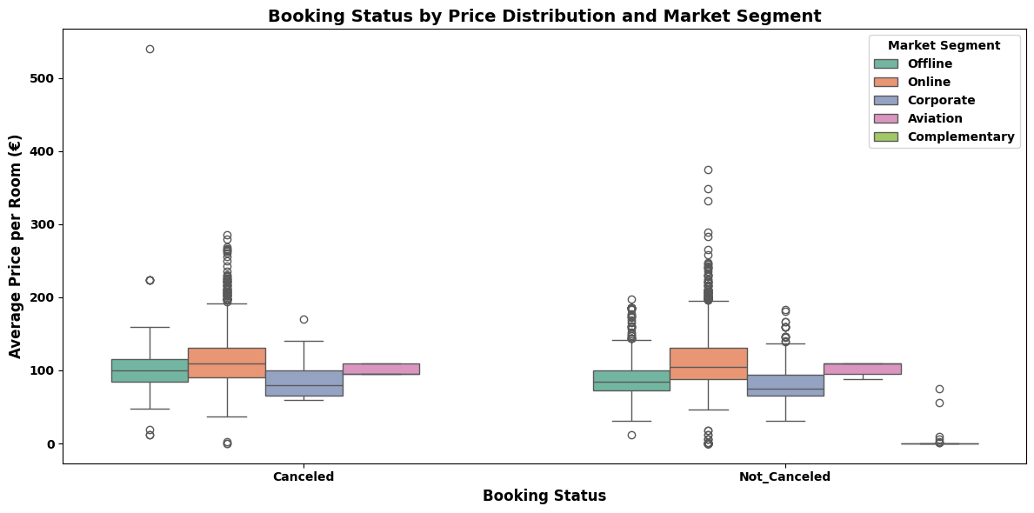
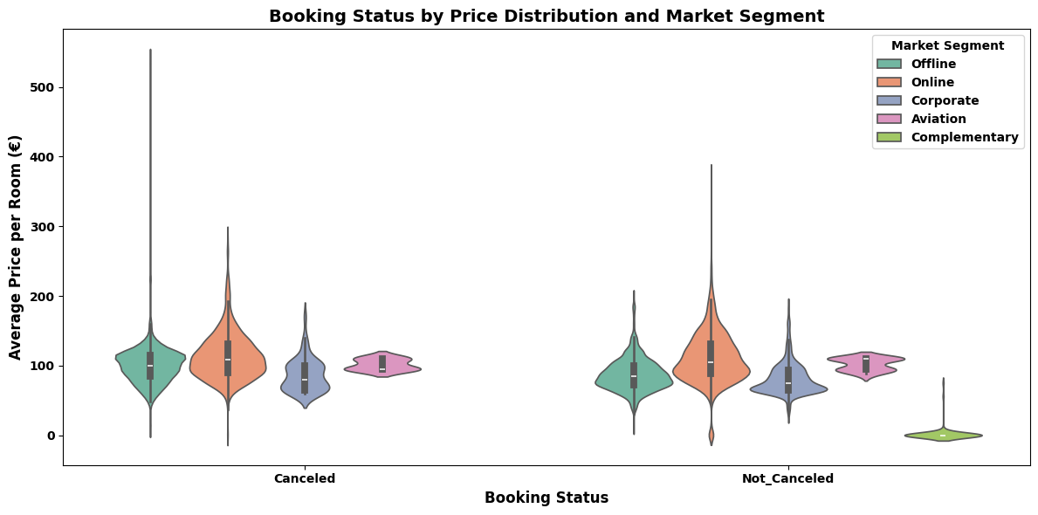
EDA - Comparing Booking Status by Price Distribution
and Market Segment
Price Distribution and Market Segment as related to Cancelled Bookings:
Prices are consistent within market segments
  Price ranges generally stay consistent within market segments regardless of booking status
Price isn’t affected by cancellations:
  Cancelled/non-cancelled have identical price distributions across all individual market segments
Offline prices have highest variability:
  Offline prices have the highest price ranges ($50 - $550) for both cancelled and non-cancelled bookings
All price levels seem to cancel equally:
  Expensive and cheaper bookings cancel at the same rates
  This proves price does not predicitive of cancellation
Recommendations:
  Since price doesn’t have a predicitive impact on cancellations, more research needs to be done to identify other cancellation reduction strategies

Slide 48
Results EDA - Bivariate Analysis
Key Findings - Bivariate Analysis
Price vs Cancellations
  Room prices have no impact on number of cancellations
  Expensive and lower priced rooms are cancelled at roughly the same rate
  Cancelled and non-cancelled rooms have identical distributions across market segments
  Price is not a predictor of client cancellations
Special Requests vs Cancellations
  Zero (0) requests have a 43% cancellation rate
  As number of requests increases, the likely of cancellation decreases substantially
  Customers making special requests are more engaged and committed
  Business and frequent guests make more requests and cancel less often
  Business trips and special events (weddings, conferences) are less likely to be cancelled

Slide 49
Results EDA - Bivariate Analysis
Market Segments vs Cancellations
  Online (~36% cancelled) Offline (~30% cancelled) bookings for roughly 95% of all cancellations
  Corporate (~10% cancelled) are a more reliable booking source – same could be probably said of frequent return clients
  Aviation bookings have minimal cancellations - standard contractual rooms - (unless flights outright cancelled)
  Comped rooms don’t get cancelled (but mismanaged can negatively affect bottom line)
Special Requests vs Cancellations
  Zero (0) requests have a 43% cancellation rate
  As number of requests increases, the likely of cancellation decreases substantially
  Customers making special requests are more engaged and committed
  Business and frequent guests make more requests and cancel less often
  Business trips and special events (weddings, conferences) are less likely to be cancelled
Booking Lead Time vs Cancellations
  Shorter lead times have higher rates of cancellations
  Same day booking has highest risk
  Longer lead times have lower rates of cancellations – more invested travelers
  Right skewed distribution with most bookings occurring within 100 days of check-in

Slide 50
Results EDA - Bivariate Analysis
Key Findings - Bivariate Analysis
Check-in Month vs Cancellations
  Peak season for cancellations is June-0ctober (summer season when most bookings occur)
  Peak season bookings tend to have longer lead times, vacation plans subject to change
  July is peak month for cancellations in terms of percentage of months booking (~46%)
  October is the worst month for the overall number of cancellations (~1400)
  Off-peak is November – April has cancellations in total or ~25% of the period’s bookings (886 of 3423 bookings cancelled)
  Winter months have shorter lead times and firmer plans (holidays, special occasions, corporate bookings)
  December has the fewest number of cancellations (13% of monthly bookings)
Revenue Impacts
  Cancellation rates have highest impact on peak booking months
  Online/Offline market segments account for highest percentage and number of cancellations
  October is the worst month in terms of negative revenue impact due to cancellations
  Corporate and Aviation bookings are the most predictable and reliable

Slide 51
Model Performance Evaluation Decision Tree
Model | Train Accuracy | Test Accuracy | Train Recall | Test Recall | Train Precision | Test Precision
Decision Tree | 99.65 | 83.20 | 99.47 | 76.77 | 99.47 | 73.23
Accuracy
  High accuracy with Training data: 99.65%, but lower with Test data: 83.20%
  The gap of 16.45% indicates significant overfitting is taking place
  Model is nearly perfect with the training data, but drops significantly with the test data
  Whatever the model learned on the training doesn’t apply well to the (new) test data
Precision
  High precision with Training: 99.47%, but significantly lower with Test: 73.23%
  The very large gap of 26.24% indicates a large number of false positives on test data
Recall
  High recall with Training: 99.47%, but significantly lower with Test: 76.66%
  Gap between training and test is high at 22.70%
  Model identified training cancellations well, but had issues with test data
Assessment/Course of Action
  The model scored poorly on test data as evidenced by the large percentage gaps
  The model is too complicated
  Apply pruning techniques to help simplify the model

Slide 52
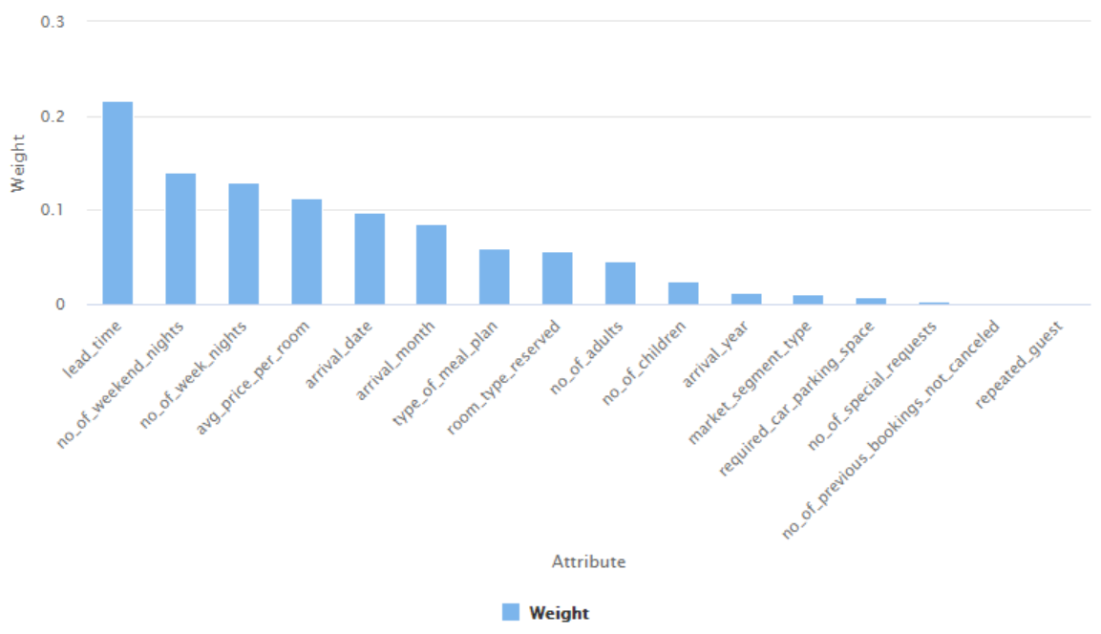
Model Performance Evaluation Decision Tree
Decision Tree Weighting:
Top Weight Features
  Lead Time (most significant), Weekend Nights, Weekday Nights, Price, Arrival Date
Medium Weight Features
  Arrival Month, Meal Plan, Room Type, Number of Adults
Low Weight Features
  Remaining features have low weight and minimal influence
Analysis:
Over-relied on Lead Time which resulted in splitting in multiple tree levels which caused overfitting
Emphasizes arrival date above arrival month
Ignored more critical features such as Special Requests, Market Segment and customer history
Redo weighting to put more emphasis on neglected features and less on weaker cancellation indicators

Slide 53
Model Performance Evaluation Pruned Decision Tree
Model | Train Accuracy | Test Accuracy | Train Recall | Test Recall | Train Precision | Test Precision
Decision Tree | 99.65 | 83.20 | 99.47 | 76.77 | 99.47 | 73.23
Decision Tree Pruned | 95.64 | 84.34 | 90.77 | 76.09 | 95.69 | 76.09
Pruned Decision Tree:
Accuracy
  High accuracy with Training data: 95.64%, with improved but still low Test data: 84.34%
  The gap of 11.30% indicates moderate overfitting is taking place
Precision
  High precision with Training: 95.69%, but significantly lower with Test: 76.09%
  The gap of 19.60% indicates a large number of false positives on test data
  Significant overfitting
Recall
  High recall with Training: 90.77%, but significantly lower with Test: 76.09%
  Gap between training and test is high at 14.68%
  Model identified training cancellations well, but had issues with test data
  Borderline moderate overfitting

Slide 54
Model Performance Evaluation Pruned Decision Tree
Decision Tree/Pruned Tree Comparisons:
Accuracy
  The gap improved by 5.2%, still needs improvement
Precision
  Gap improved by 6.6%, still needs improvement
Recall
  Gap improved by 8.0%, but needs improvement
Assessment/Course of Action
  Pruning reduced overfitting
  The gaps are better for Pruned Decision Tree, but still high
  Another round of pruning to further simplify and improve the model?
  Try Random Forest as a different approach

Slide 55
Model Performance Evaluation Random Forest
Model | Train Accuracy | Test Accuracy | Train Recall | Test Recall | Train Precision | Test Precision
Random Forest | 98.47 | 87.94 | 96.44 | 77.10 | 98.87 | 84.71
Accuracy
  High accuracy with Training data: 98.47%, but lower with Test data: 87.94%
  The gap of 10.53% indicates moderate overfitting is taking place
Precision
  High precision with Training: 98.87%, but significantly lower with Test: 84.71%
  The gap of 14.16% is better, but still considered high
  Moderate overfitting
Recall
  High recall with Training: 96.44%, but significantly lower with Test: 77.10%
  Gap between training and test is still high at 19.34%
  Significant overfitting
Assessment/Course of Action
  Model performed better than Decision Tree/Pruned Decision Tree except for Recall
  Overfitting is taking place
  Try Prunded Random Forest next

Slide 56
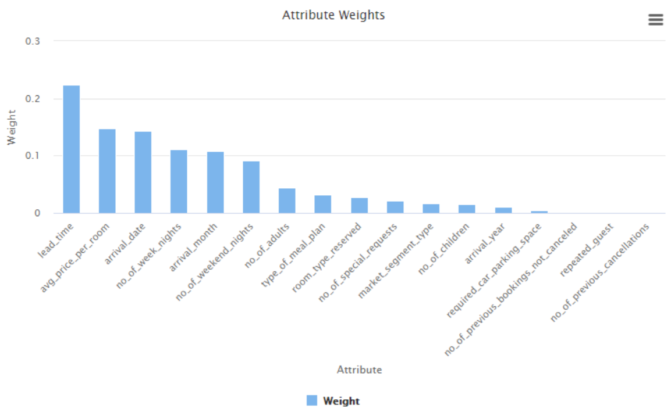
Model Performance Evaluation Random Forest
Random Forest Weighting:
Top Weight Features
  Lead Time (most significant), Room Price, Arrival Date, Weeknights Nights, Arrival Month, Weekend Nights
Medium Weight Features
  Number of Adults, Meal Plan, Room Type, Special Requests, Market Segmentsegment
Low Weight Features
  Remaining features have low weight and minimal influence
Analysis:
Lead Time is still the top weighted feature similar to Decision Tree, Random Forest did not reduce it’s effect, still overfitting
Room price made more significant
Still emphasizes arrival date above arrival month
Special Requests, Market Segment and customer history are still ignored
Redo weighting to put more emphasis on neglected features and less on weaker cancellation indicators

Slide 57
Model Performance Evaluation Pruned Random Forest
Model | Train Accuracy | Test Accuracy | Train Recall | Test Recall | Train Precision | Test Precision
Random Forest | 98.47 | 87.94 | 96.44 | 77.10 | 98.87 | 84.71
Random Forest - Pruned | 87.32 | 85.04 | 69.86 | 66.22 | 89.09 | 84.77
Pruned Random Forest:
Accuracy
  Training data: 87.32%, with Test data: 85.04%
  The gap is 2.28% with minimal overfitting
Precision
  Training: 89.09%, with Test: 84.77%
  The gap of 4.32% with minimal overfitting
Recall
  Training: 69.86%, with Test: 66.22%
  Gap is 3.64% with minimal overfitting
  Recall is very low though

Slide 58
Model Performance Evaluation Pruned Random Forest
Random Forest/Pruned Random Forest Comparisons:
Accuracy
  Improved with pruning
Precision
  Improved with pruning
Recall
  Marked decline with pruning
Analysis/Course of Action
  Overfitting was dramatically reduced
  Better training scores
  Better generalized model
  Recall dropped by 10.88%
  Accuracy dropped by 2.90%
  Possible that model is overpruned
  Model might be overly simplified
  Scale back amount of pruning for Random Forests and rerun

Slide 59
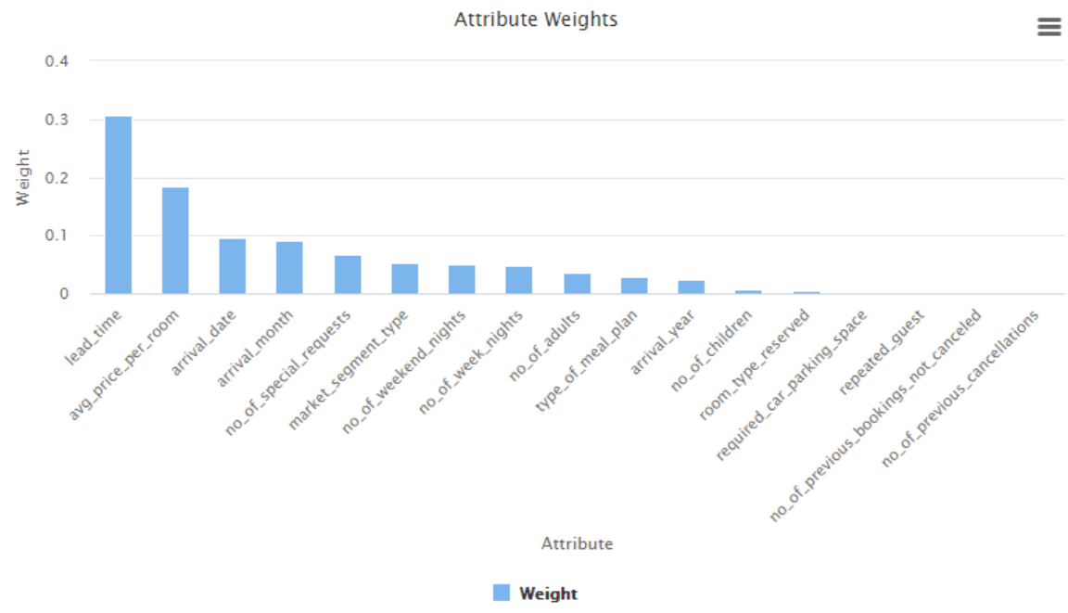
Model Performance Evaluation Pruned Random Forest
Pruned Random Forest Weighting:
Top Weight Features
  Lead Time (most significant), Room Price, Arrival Date, Arrival Month, Special Requests, Market Segment
Medium Weight Features
  Weekend Nights, Weekday Nights, Number of Adults, Meal Plan, Arrival Year
Low Weight Features
  Remaining features have low weight and minimal influence
Analysis:
Lead Time is a more dominant weight
Room price is even more significant
Special Requests, Market Segment are more strongly weighted
Customer history are still ignored
Resulted in significantly lower Recall
Over pruning, over simplified model

Slide 60
Model Performance Summary
Model | Train Accuracy | Test Accuracy | Train Recall | Test Recall | Train Precision | Test Precision
Decision Tree | 99.65 | 83.20 | 99.47 | 76.77 | 99.47 | 73.23
Decision Tree - Pruned | 95.64 | 84.34 | 90.77 | 76.09 | 95.69 | 76.09
Random Forest | 98.47 | 87.94 | 96.44 | 77.10 | 98.87 | 84.71
Random Forest - Pruned | 87.32 | 85.04 | 69.86 | 66.22 | 89.09 | 84.77
Random Forest is the best model for the business objective:
  Highest test data Accuracy (87.94%), Precision (84.71%) and Recall(77.10%)
  Of the 4 models, this had acceptable levels of overfitting (not best – which resulted in crashed Recall numbers)
  Not pruned, which could lead to model oversimplifcation
Most important evaluation metric:
  Recall – how many of the actual cancellations were we able to catch?
  Missed cancellations directly result in either lost/reduced revenue or increased cost required to fill empty rooms
Features used by model to make predictions
  Lead Time, Room Price, Arrival Date, Week Nights, Check-in Date,Weekend Nights are top features
  Special Requests is the most ignored feature, followed by Market Segment, Repeat Guests, and Previous Cancellations
  even though they were high scoring in Bivariate Analysis
Action Items/Follow up
  Use Random Forest Model for Cancellation risk assessment
  Implement post booking client follow up program (emails, notifications, in some higher risk situations: phone calls)
  Increase foothold in Corporate and Aviation Market Segments; they are lower risk
  Evalulate and enhance the overbooking strategy – knowing a percentage of rooms will be cancelled, have means to fill them
  After model has been in use for a while, evaluate its real performace. If necessary, alter the model weights to put more
  emphasis on identified higher impact features

Slide 61
Conclusions and Recommendations
Analysis Summary and Recommendations
Special Requests: Most Import (Magic Bullet) Cancellation Indicator
  Findings:
    Strongest predictor of cancellations in the dataset
    The fewer special requests a client has, the more likely the are to cancel
    Zero requests has a cancellation rate of ¬43%
    As the number of special requests increases, cancellation rates decrease dramatically
    Combination of long lead times and no special requests is a high risk cancellation indicator
    Holds true across all market segments
  Recommendations:
    Create prominent prompts for adding special requests during the booking experience
    Offer bundled special request packages at a discount
    Stricter cancellation policy and higher required deposits for zero special requests customers
    More flexible cancellation policies for special request clients
    Mitigate risk through a scheduled program of follow up communications and confirmations
    Save premium rooms for clients with multiple special requests
Target Market Segments
  Findings:
    Online/Offline bookings account for most of the cancellations (97%)
    Corporate and Aviation are lowest risk
  Recommendations:
    Re-evaluate Online/Offline booking and cancellation policies
    Expand footprint in Corporate and Aviation segments
    Increase marketing to entice more low risk clients

Slide 62
Conclusions and Recommendations
Seasonal Booking Patterns
  Findings:
    Peak seasons have a higher number of cancellations
    July and October have the highest number/rate of cancellations
    Offseason bookings have fewer cancellations and are more stable
  Recommendations:
    Peak Season
      Non-refundable deposits
      Shorten booking window
      Stricter cancellation policies
      Strategic overbooking
      Increased customer follow up
    Offseason
      Target corporate markets and repeat customers
      Create vacation stay packages to entice clients
      Increase customer loyalty programs
      Lower room deposits
      Extended stay discounts
      Last minute sales/deals
    Increase marketing to entice more low risk clients
Customer Experience Improvements and Cancellation Reductions
Surprising low number of repeat customers indicates a less than optimal guest experience during their stay
  Repeat Clients:
    Revamped Customer Loyalty program with enhanced benefits for premium clients
    VIP services for most frequent guests
    Express check-ins for loyalty program members
  New Customers:
    Personalized post booking follow up
    Track preferences and requests
    Encourage guests to join rewards/loyalty program
  All Customers:
    Solicit customer feedback to identify where the hotel is failing to deliver on filling client needs
    Take a critical look at the entire process (booking – check-in – stay – check-out)
    Review hotel operations : room cleanliness, staff-guest interactions, front desk, amenities, are some upgrades in order?

Slide 63
Conclusions and Recommendations
Lead Times and Cancellations
  Findings:
    Lead Time is a strong indicator of potential cancellations
    Long Lead Times (200+days) have high cancellation rates
    Short lead times (< week) also show risk
    Optimal Booking Window (30-100 days) has lowest cancellations
  Recommendations:
    Combine longer lead times with special requests to reduce risks
    Require higher deposits for longer lead times
    More aggressive program of customer follow up post booking
    Price breaks for bookings occurring within Optimal Window
Cancellation Impact on Revenue and Resources
  Findings:
    Random Forest model is the clear choice of the options presented in this study
    Random Forest model identifies 77% of cancellations before they occur
    Still miss 23% of cancellations (high) – requires additional fine tuning
    Random Forest modeling is more cost effective in terms of computational resources
    Each cancellation is worth $150-$300 in lost revenue if room is left vacant
    Reduced revenue occurs if room is rebooked at lower price
    Cancellations cost company resources in terms rebooking expenses
  Recommendations:
    Proactive overbooking strategies
    Increase customer follow up
      High Risk – direct contact
      Medium Risk – scheduled automated reminders
      Low Risk – standard confirmations

Slide 64
Conclusions and Recommendations
Additonal Recommendations
Market Segments
  Promote property site for conventions and special events to coporate clients
  Reach out to airlines generate new business in the aviation sector
  Investigate new possible market segments
  Reface online and media presence
Seasonal Booking
  Off peak season promotions – special theme weekends and events
  Discount extended stays for off peak bookings
  Pursue corporate opportunites (events, meetings, getaways) more aggressively
Number of Guests
  Promote more family vacations
  Offer bundled family get aways and themed weekends
  Offer reduced rates to corporate/avation customers for personal travel
  Promotions targeting frequent travelers
  Referral incentives
Promote Special Requests
  Provided bundled special requests at discounts
  Online property and room virtual tours
  Ability for custom requests
Partnerships and Packages
  Offer prepaid activites through local attractions
  Bundled savings (hotel, car rental, flights)
  Dining discounts at local restaurants
  Advance booked packages for local expiences (wine tasting, hiking, biking, tours)

Slide 65
APPENDIX

Slide 66
Slide Header
Please add any other pointers (if needed)

